Slide 1
PARTY APP
-Amish GarHwal(1860961)
DhAIrya Jaiswal(1824902)
Nitin Prince Reuben(1858105)

Slide 2
Introduction
To provide 1 platform where you can rent every necessary equipment for a house party, Birthday celebration or any function
To provide customer with an opportunity to collaborate with us which will help them earn money and also keep the unused equipment circulated
To bring together skilled labor and provide them an interface to contact with customers directly.

Slide 3
Use Cases
Creating new Users
Managing Suppliers
Customers ordering products
Suppliers giving live status about products including his grievances
Supplier contacting with skilled labor to perform the task
Suppler contacting delivery person for transportation of products
Customer becoming Supplier

Slide 4
Actors
System Admin
Supplier
Customer
Delivery Personnel
Skilled Labor

Slide 5


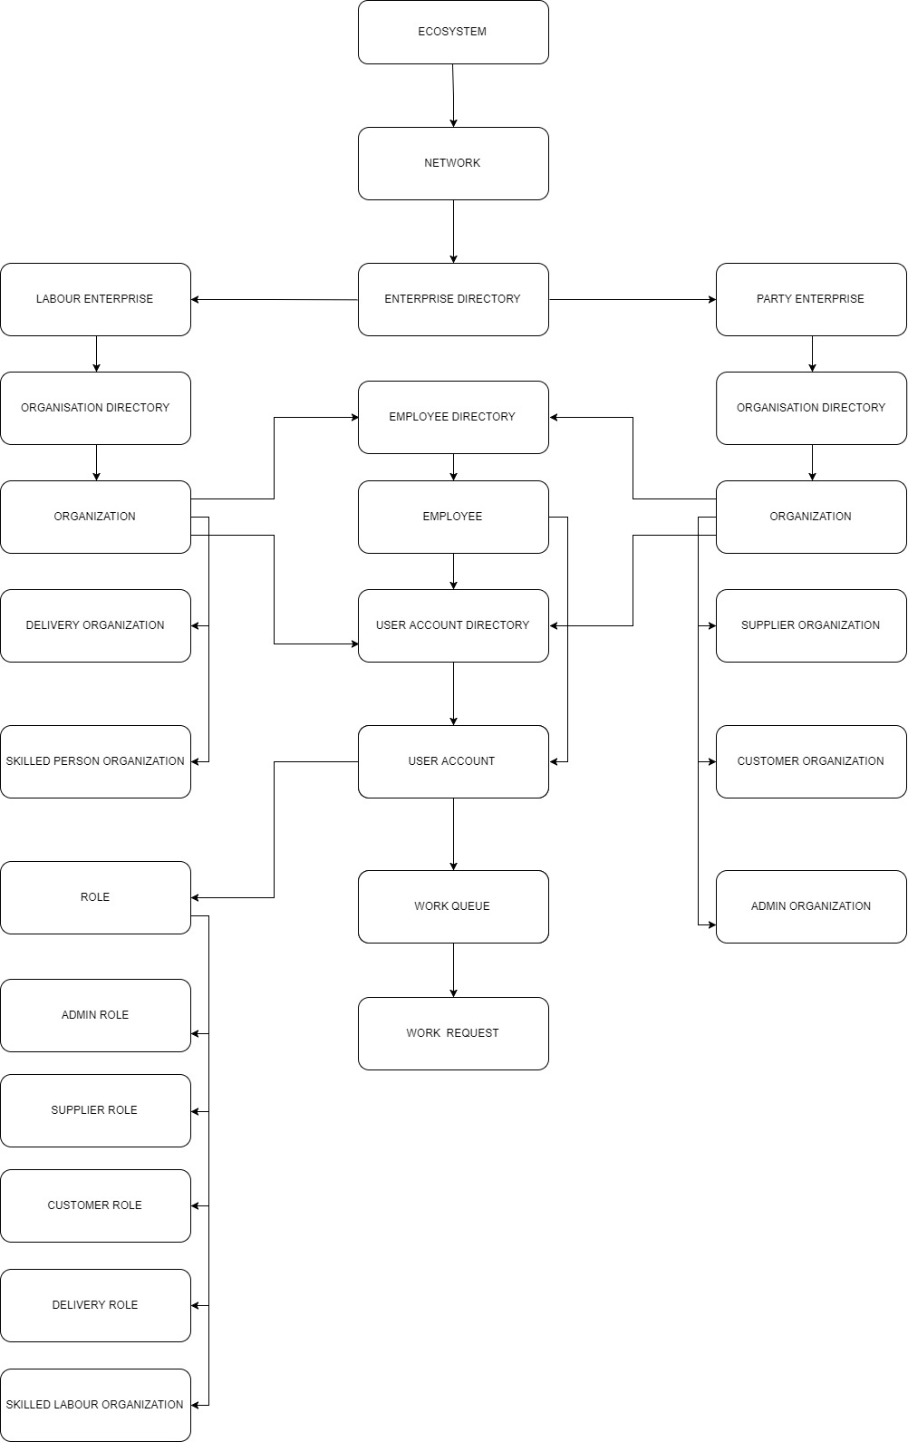




Slide 6
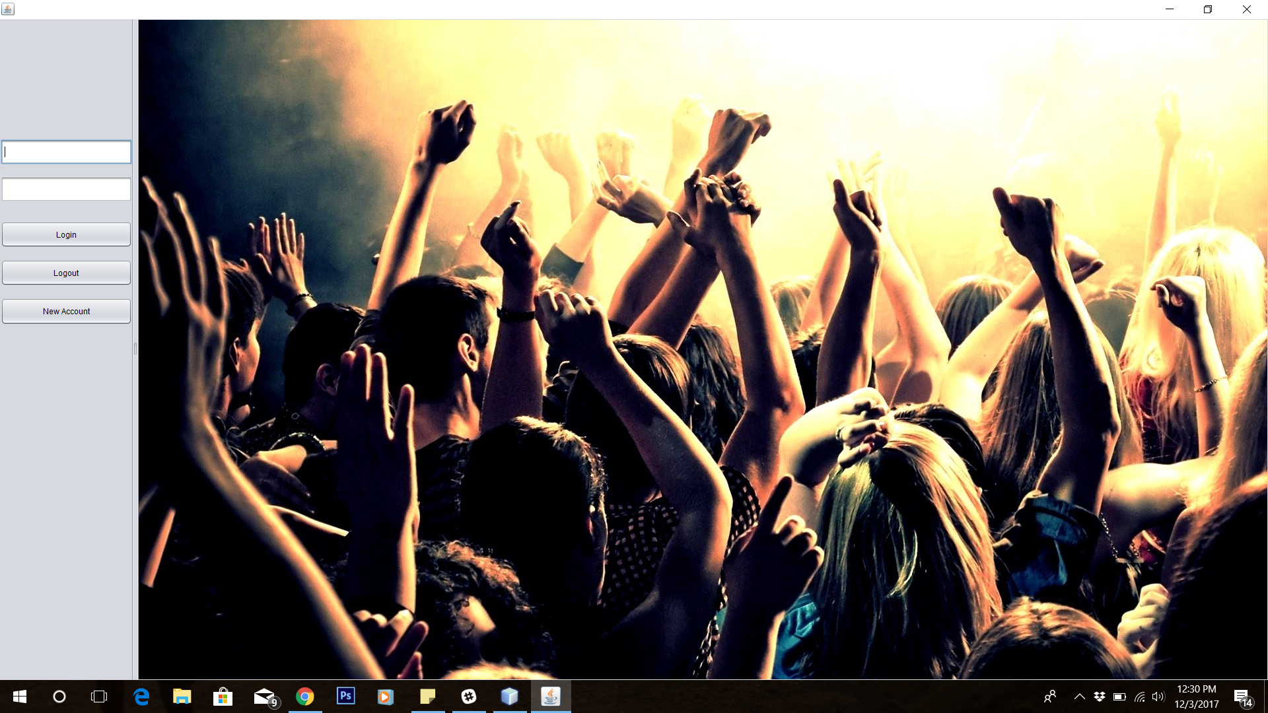

Slide 7
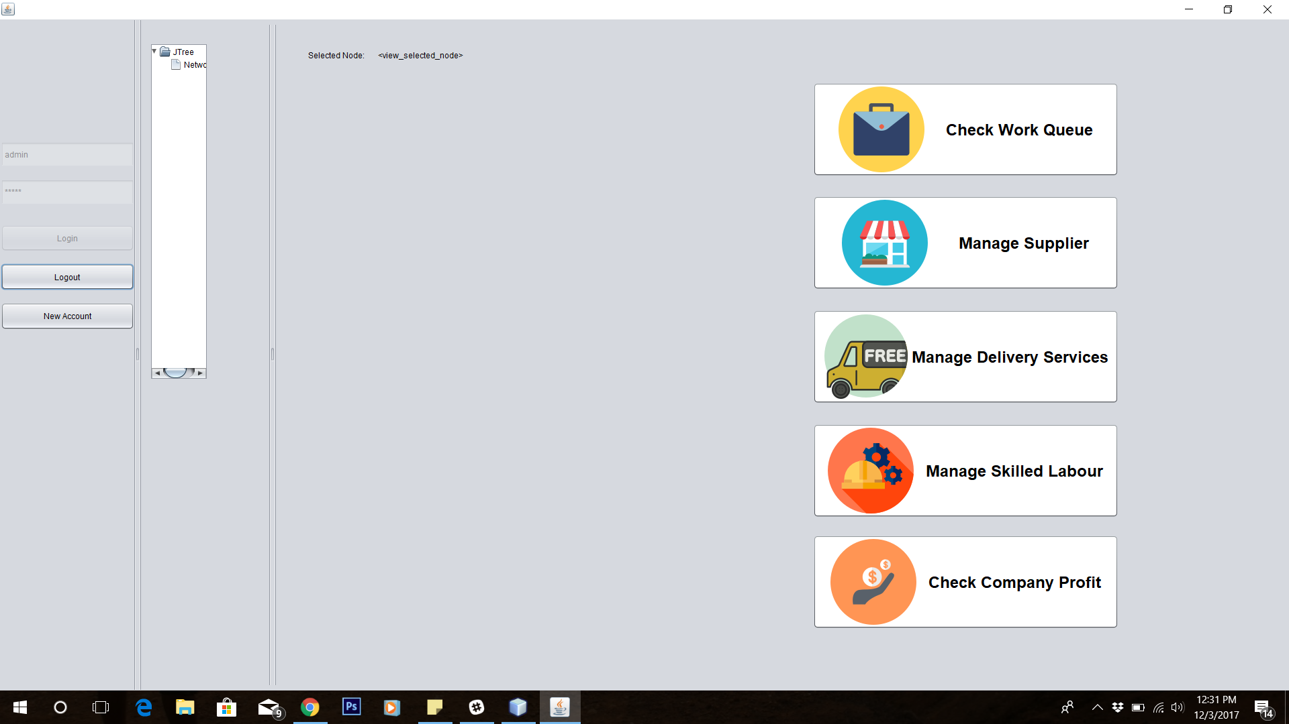

Slide 8
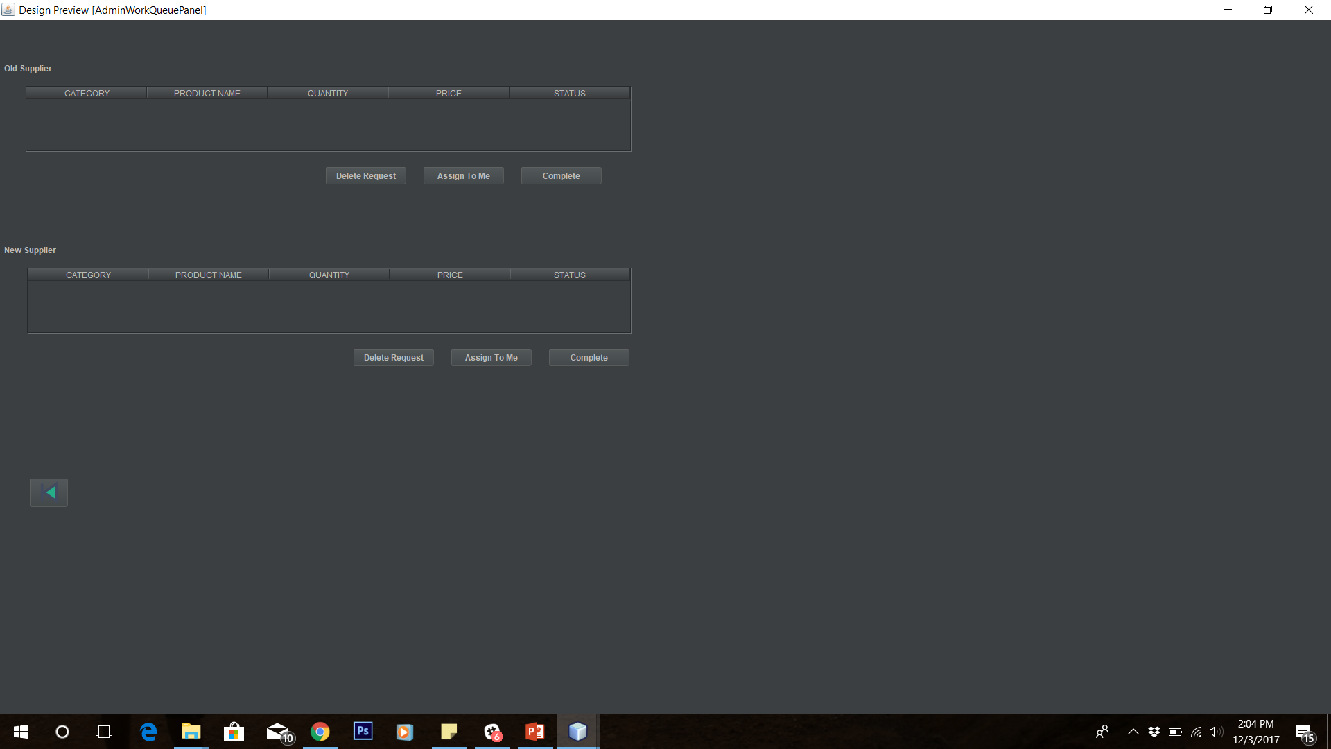

Slide 9
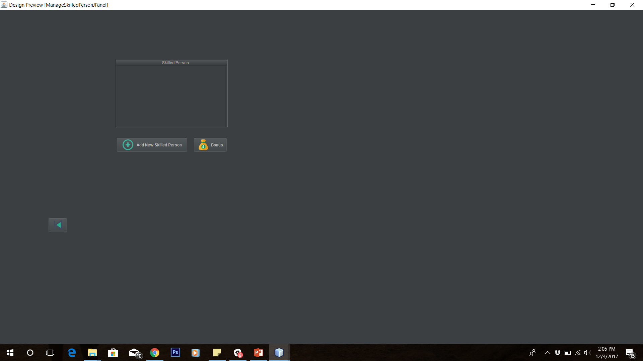

Slide 10
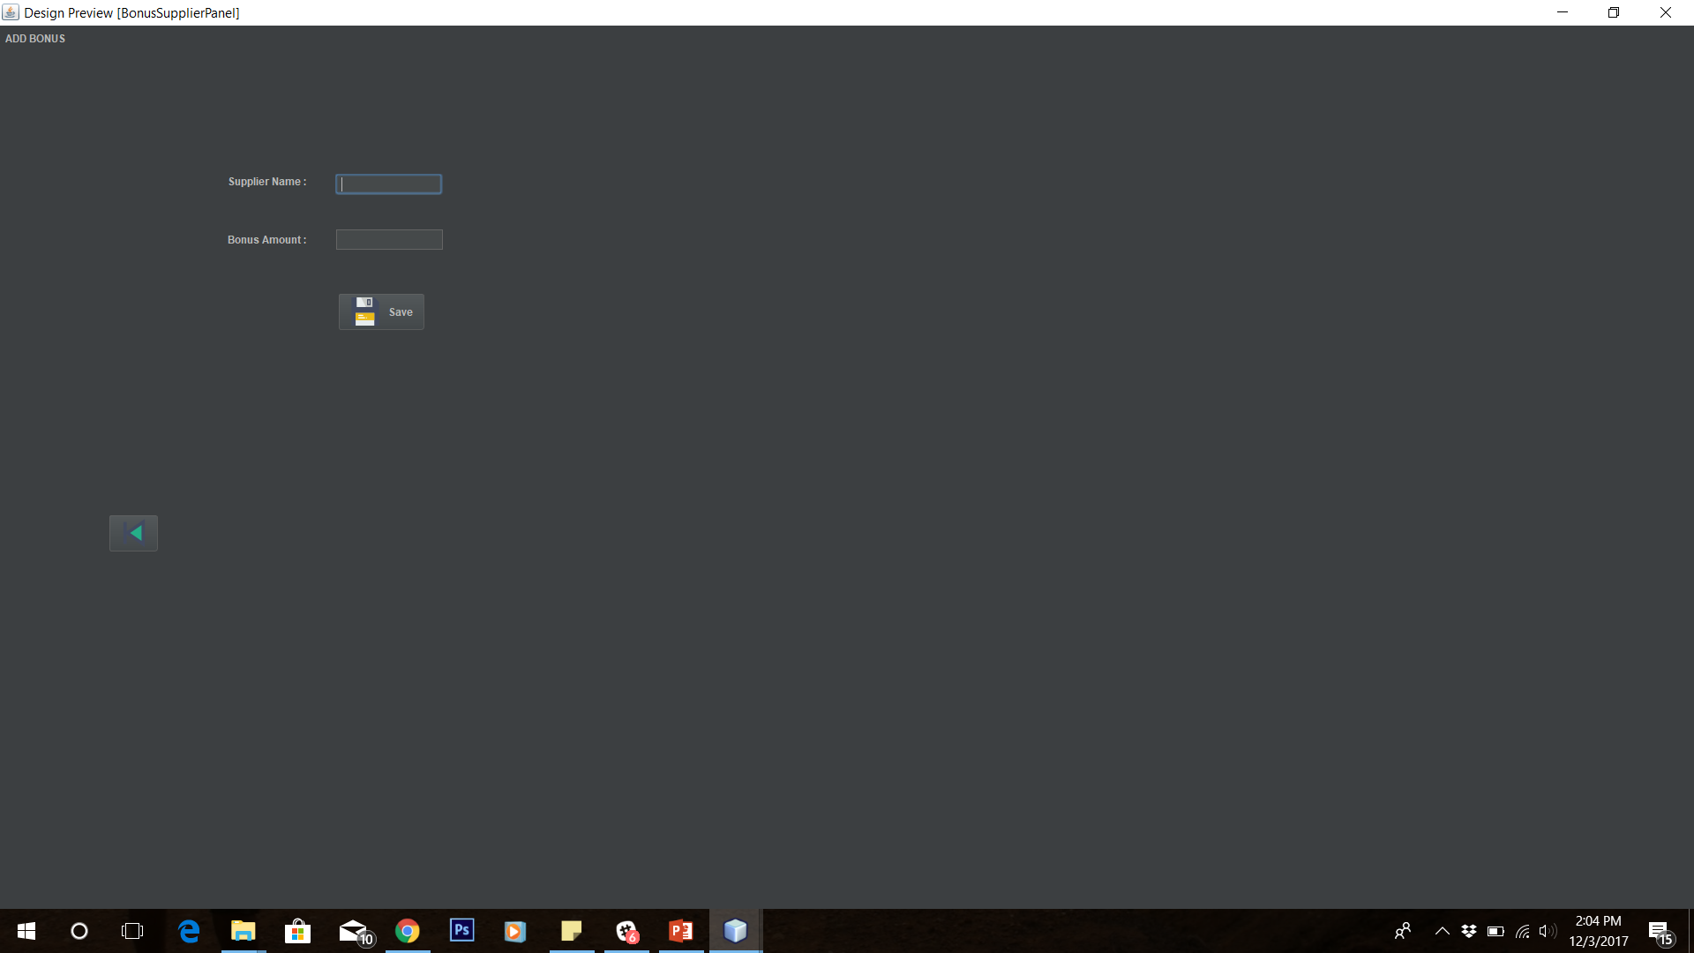

Slide 11
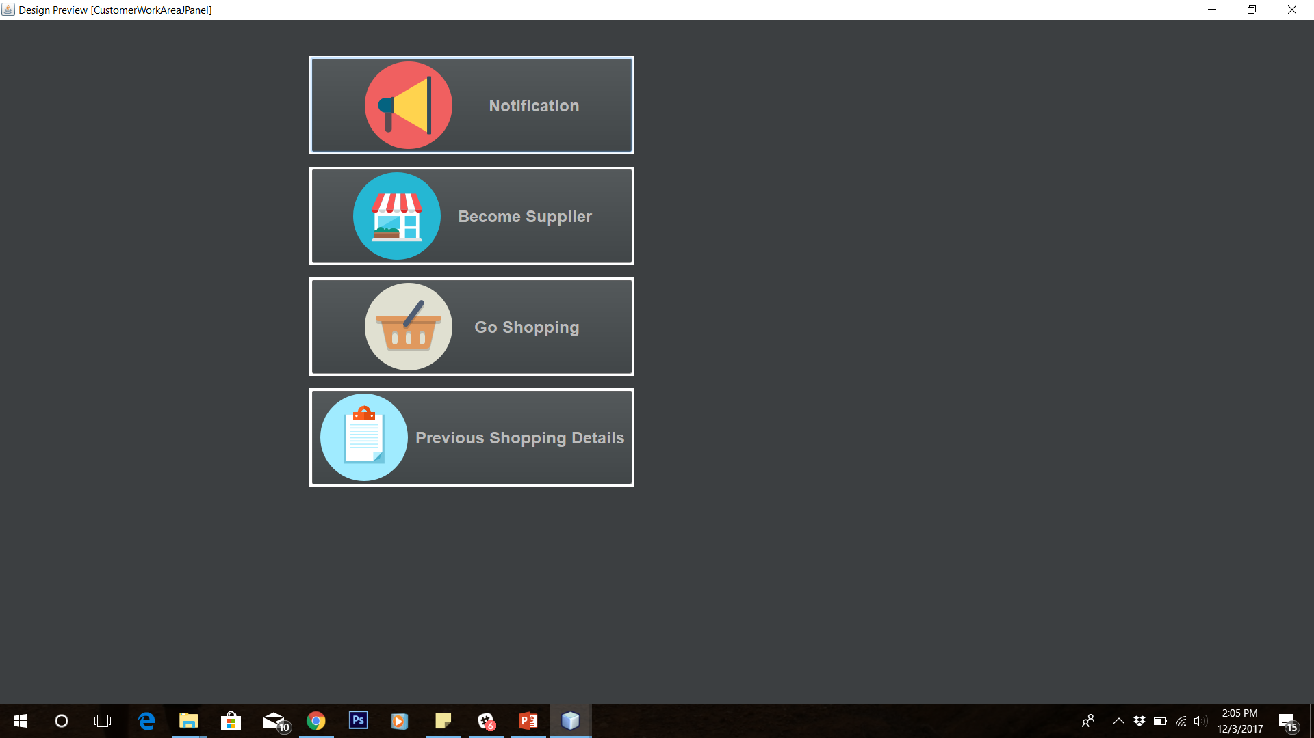

Slide 12
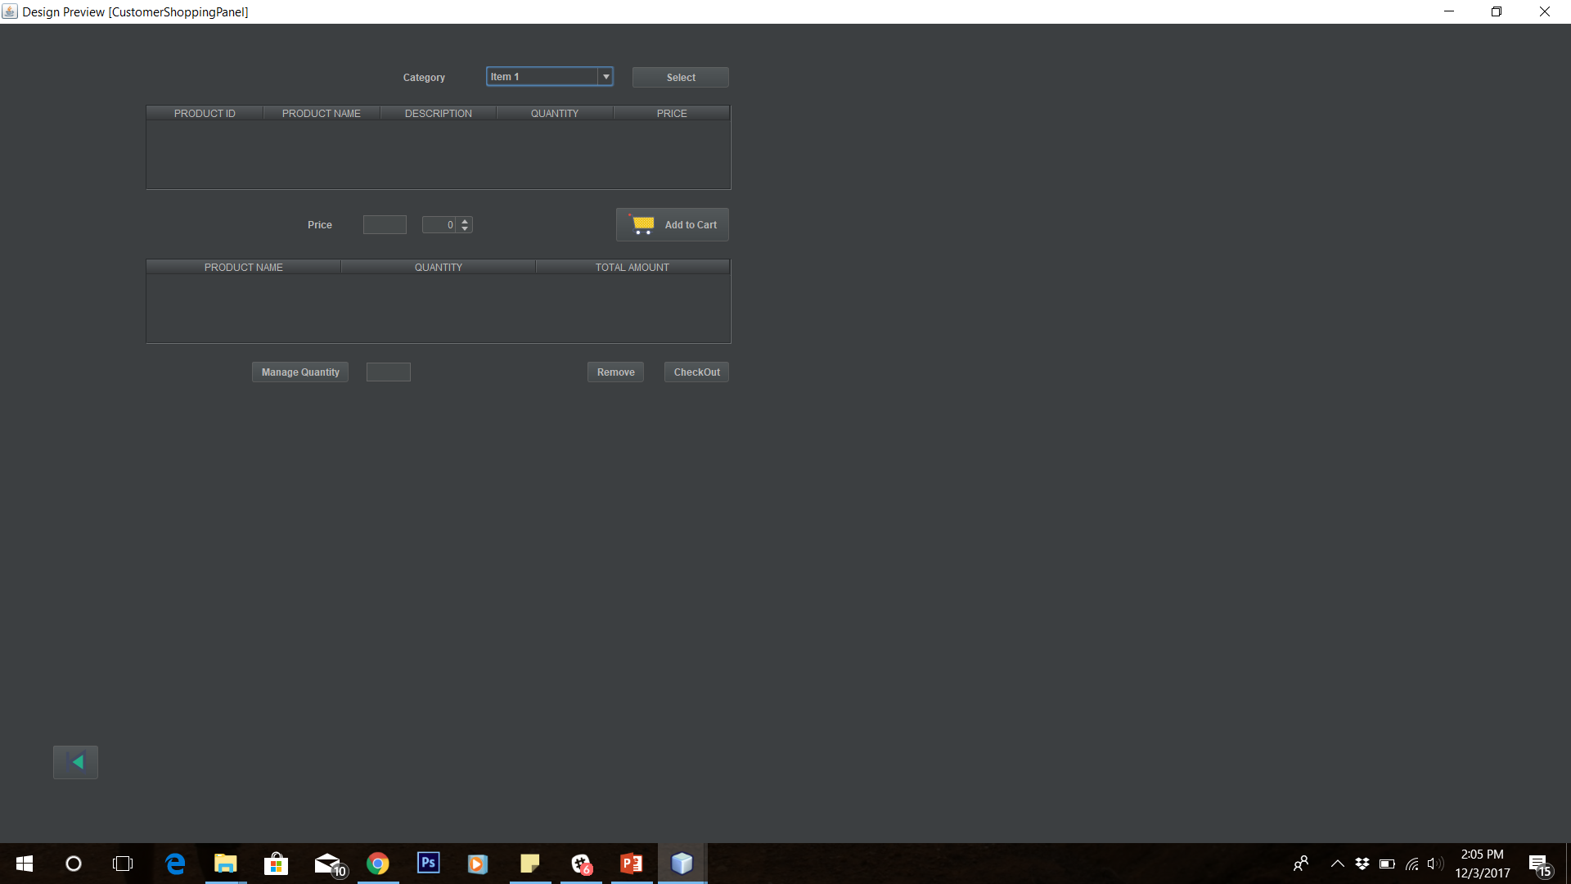

Slide 13
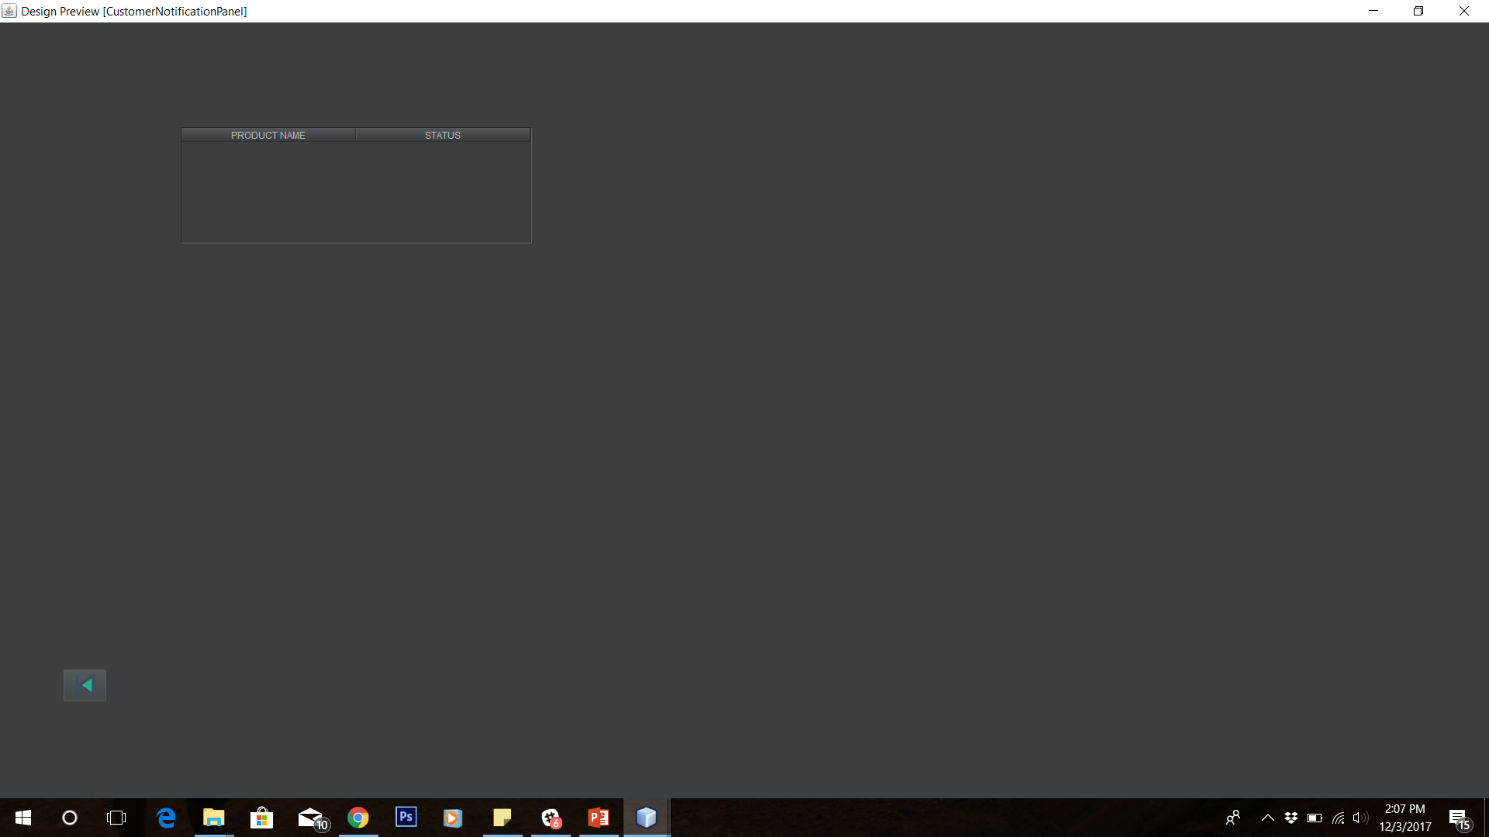

Slide 14
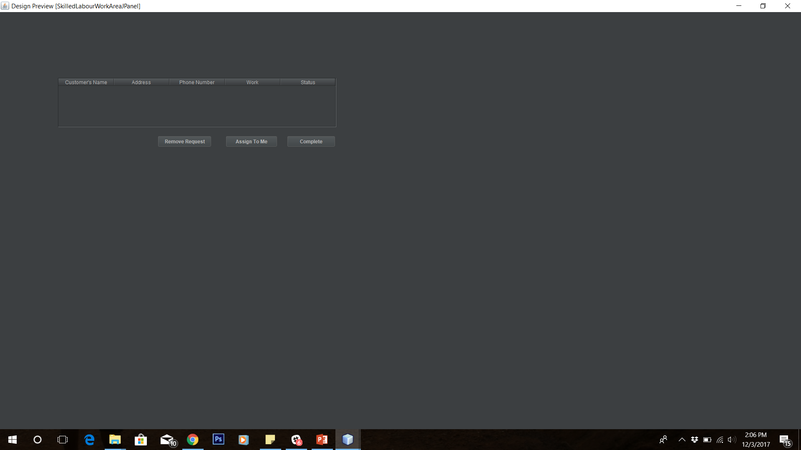

Slide 15
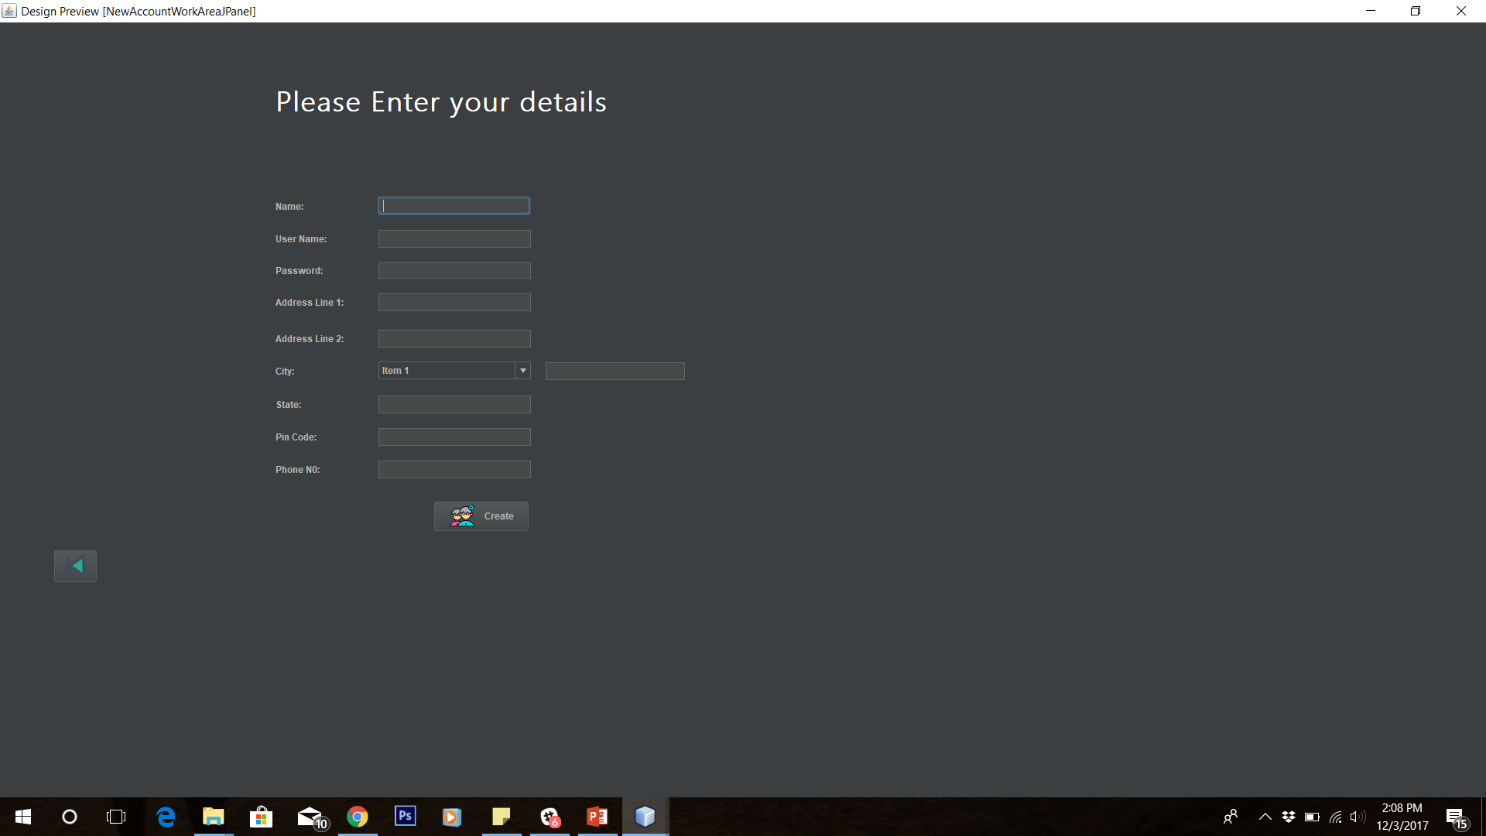

Slide 16
DEMO

Slide 17
THANKYOU

